Slide 1

AIMS Redesign Subcommittee
June 3rd, 2024
Full-Committee Meeting

Slide 2
Agenda
Recap
AIMS Website
Template Changes
Additional Metrics
Wording Changes

Slide 3
Recap
Template Changes
Additional Metrics
Wording Changes
April Meeting Recap
CIP Code Length = 6 digits
Add IRB position to Current Administration list
First Time Student Tab = Fall term only
Drop down list for Tribal Affiliation
Part B will remain a separate word doc
Remove Academic Award from Outside Institution from Student Activities

Slide 4
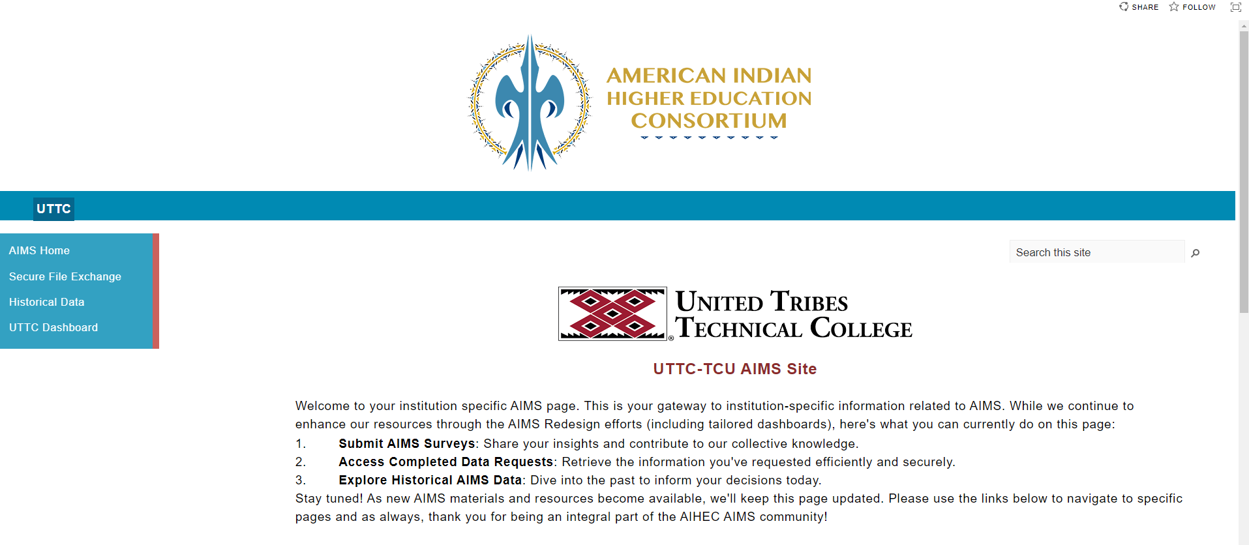
Recap
Template Changes
Additional Metrics
Wording Changes
AIMS Website
Volunteers to explore and provide feedback?
Issues with providing TCUs with redesign committee materials?
  Change Log
  In Progress Codebook
  Slides

Slide 5
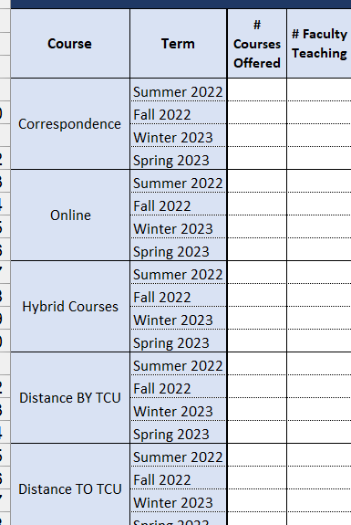
Recap
Template Changes
Additional Metrics
Wording Changes
Codebook Working Group Proposed Changes
Changes to Distance Learning Tab:
Items to Remove
  Distance TO TCU
  Distance BY TCU
  # of Courses Offered
  # of Faculty Teaching
Categories to Add:
  Face to Face
  Course Sharing
    Partnering institution type (e.g., other TCU, state institution, etc.)
    Subjects of courses shared
Combine Distance Learning Tab with Course Completion
Table
Rename section from “Distance Learning” to “Learning
Modalities”

Slide 6

Recap
Template Changes
Additional Metrics
Wording Changes
Annual Survey
Identify which sections should be duplicated vs. unduplicated numbers

Slide 7
Recap
Template Changes
Additional Metrics
Wording Changes
Annual Survey
Identify which sections should be duplicated vs. unduplicated numbers
Student Tribal Affiliation
First Time Student Demographics
General Student Demographics
Financial Resources
Fall Enrollment/Enrollment by Degree Program
Completion
Academic Core
Remedial Development
Distance Learning
Student Activities
Students with Impairments
Fall/Spring Survey: Student Enrollment (with added dual enrolled/dual credit/transfer in students)

Slide 8
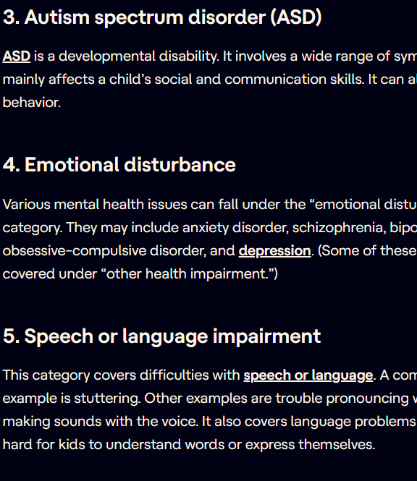
Additional Metrics
Students with Health Conditions/ Impairments Tab
  Type of impairment
    Individuals with Disabilities Education Act has a list of 13 categories
  Accommodations provided by institution
Transfer Student Tab?
  Transfer-Out rate
  Transfer-In enrollment
  Institution transferring from
  Incoming credits
  Previous Degree Program
  Enrolled Degree Program
  Demographics?
Recap
Template Changes
Additional Metrics
Wording Changes

Slide 9

Additional Metrics
Anytime Graduation Rate
Unduplicated Headcount by
  Degree/Non-Degree Seeking
  AI/AN/Non-AI/AN
Student Employment Status (While Enrolled)
  Part-Time
  Full-Time
  Seasonal
  Not-Working
Internet Connectivity
  ISP Provider
  Connectivity Speeds (in Mps)
  Annual Internet Costs
Recap
Template Changes
Additional Metrics
Wording Changes

Slide 10

Additional Metrics
International Students:
  International Student Enrollment by Visa Type
    F-1, J-1, and M-1
  Student’s Home Country
  Program of Enrollment
  Financial Aid offered
  Post-graduation employment/future education.
  Does TCU have formal relationships with universities abroad?
    What countries and universities?
Recap
Template Changes
Additional Metrics
Wording Changes

Slide 11
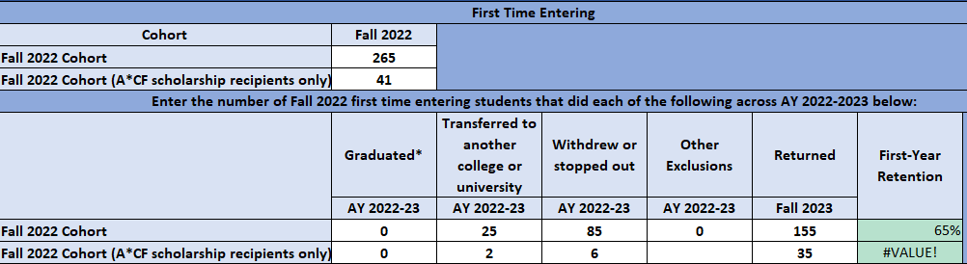
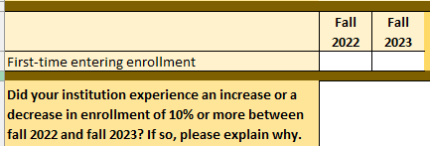
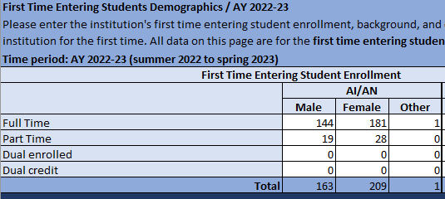
Wording Changes
Annual: First Time Entering -> First Time Ever in College
Fall/Annual: First Time Entering -> New to Institution
Recap
Template Changes
Additional Metrics
Wording Changes

Slide 12
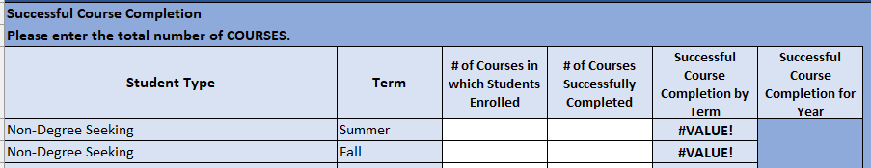
Wording Changes
Annual: # of Courses in which students enrolled/completed -> Total Course Enrollment/Total Successful completers
Recap
Template Changes
Additional Metrics
Wording Changes

Slide 13
Next Steps
Codebook and Qualtrics Translation Working Group Meetings
Next Month’s Focus:
  Freeze Date/Census Discussion
  PDP Overlap

